Slide 1
Terry Stokes CEO tstokes@lasa.org.uk
rightsnet.org.uk

Slide 2
Austerity Welfare Reform Legal Aid changes
rightsnet.org.uk

Slide 3
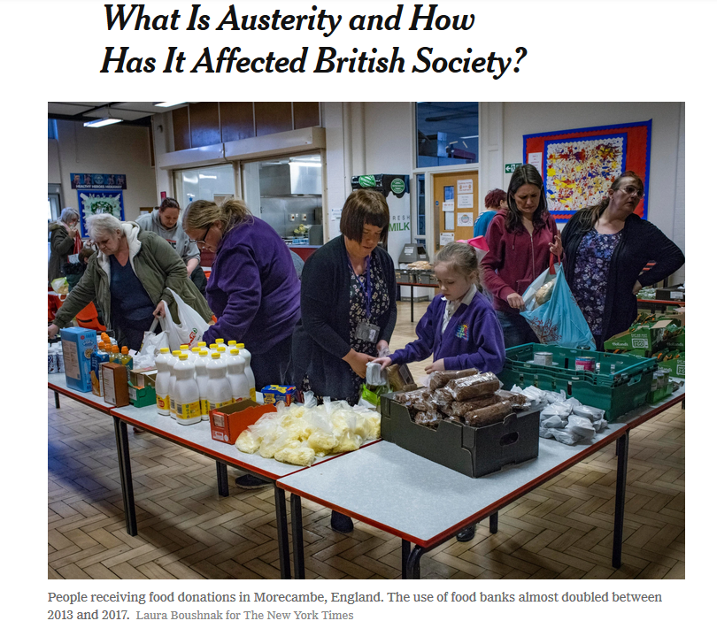
rightsnet.org.uk

Slide 4
Public Spending cuts Institute for Fiscal Studies - “We’ve had £40 billion of cuts to department spending and cuts of 30 percent and 40 percent to some budget items.”
rightsnet.org.uk

Slide 5
£12bn cuts in benefits Universal Credit rollout
rightsnet.org.uk

Slide 6
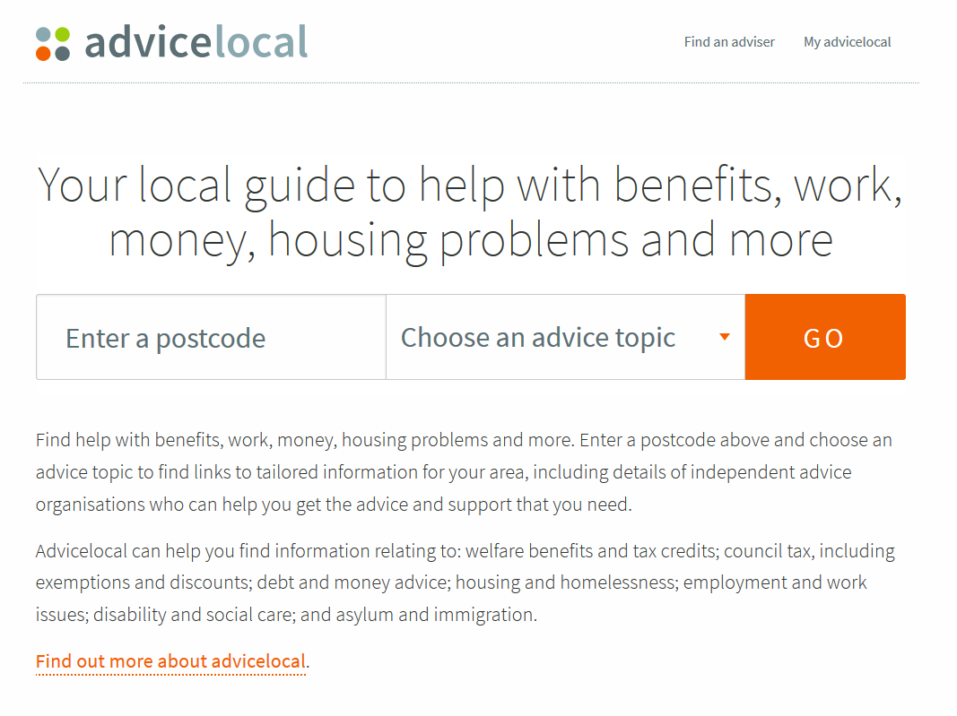
rightsnet.org.uk

Slide 7
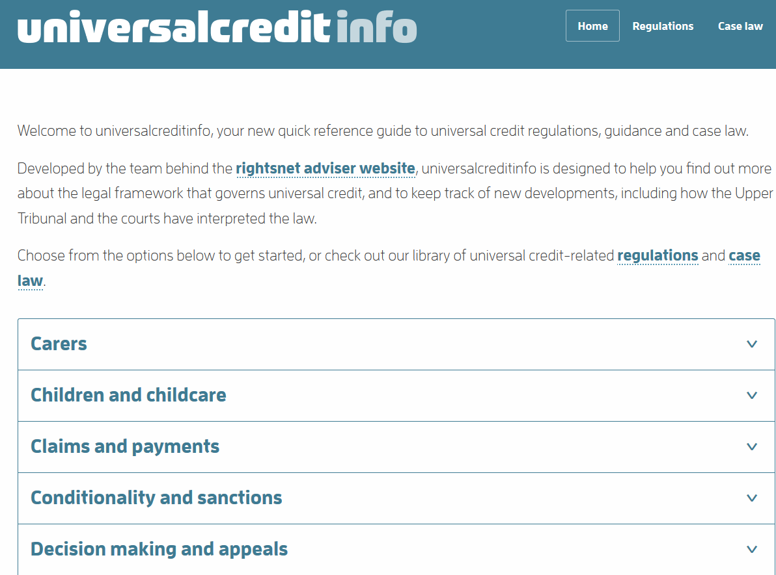
rightsnet.org.uk

Slide 8
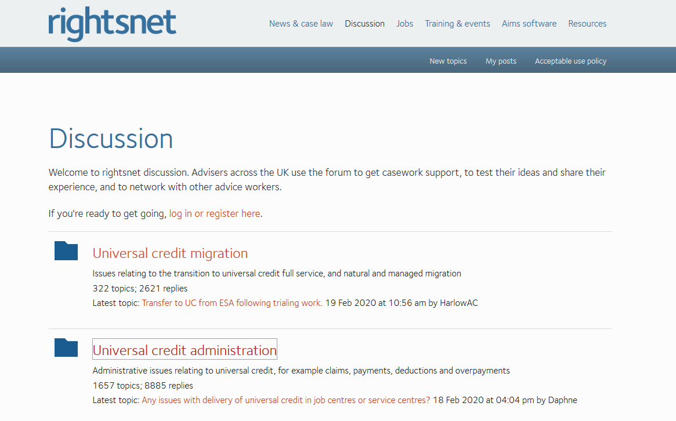
rightsnet.org.uk

Slide 9
LASPO
rightsnet.org.uk

Slide 10
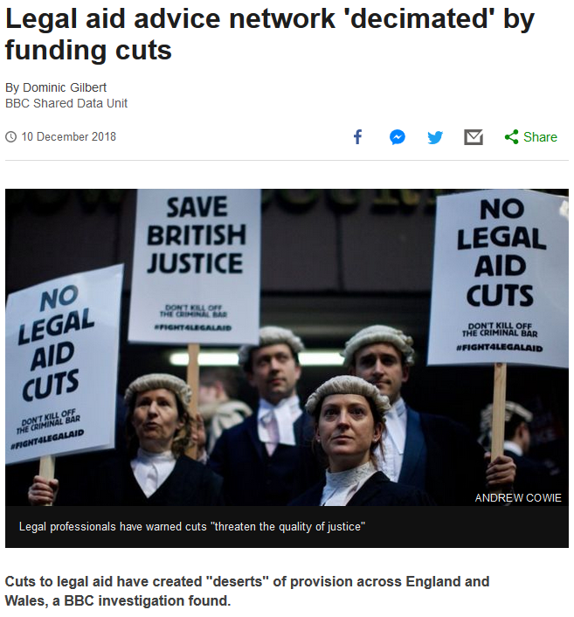
rightsnet.org.uk

Slide 11
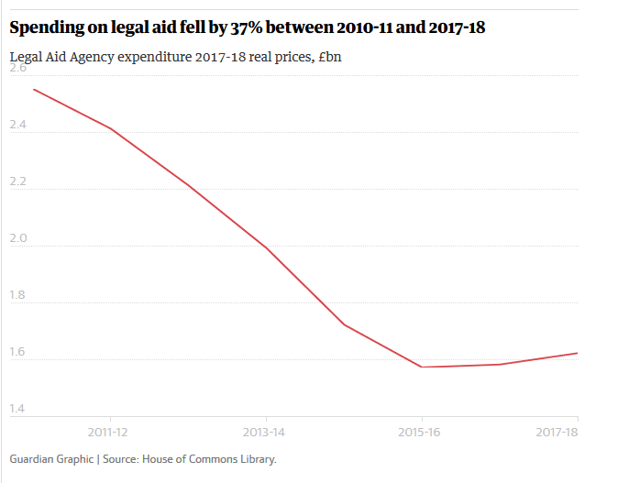
rightsnet.org.uk

Slide 12
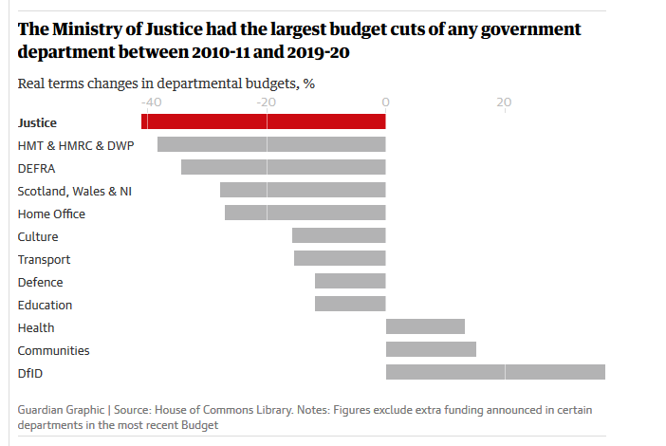
rightsnet.org.uk

Slide 13
What does all this mean for advice services?
rightsnet.org.uk

Slide 14
tstokes@lasa.org.uk @rightsnet rightsnet.org.uk

